Slide 1


CENTERING, SHUTTERING AND DE- SHUTTERING
JITENDRA SHAH 2014037/2004437

Slide 2






SHUTTERING
FORMWORK
CONTENT
CENTERING
DE-SHUTTERING

Slide 3
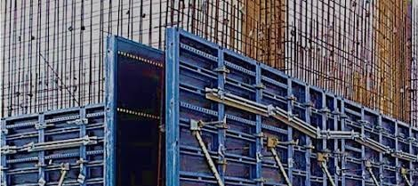
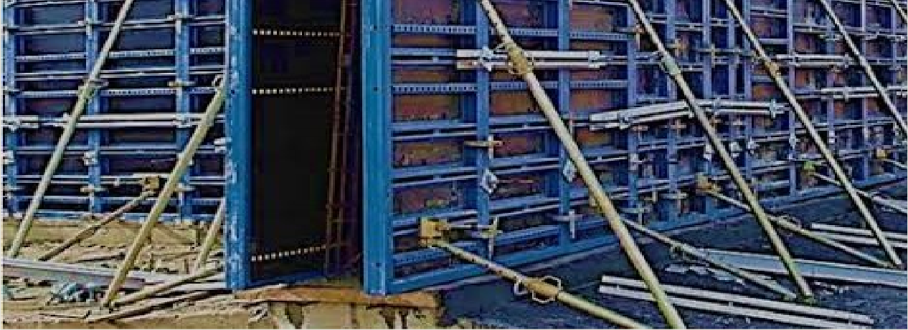
FORMWORK, Mold
used to form concrete into structural shapes (beams, columns, slabs
, shells) for building.
Formwork can be of timber, steel, plastic, or fiberglass. The inside surface is coated with oil to keep the concrete from sticking to the mold.

Slide 4
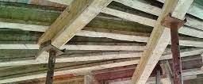
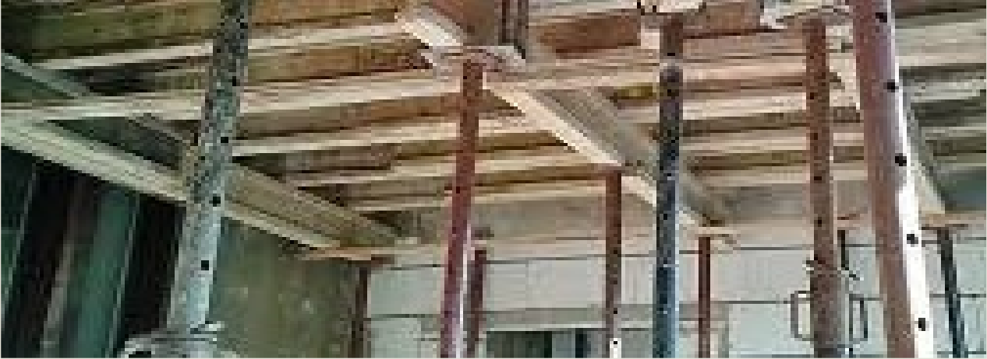
CENTERING is used to support horizontal members.
Hence, formwork for
floor beams and slabs is known
as centering.

Slide 5
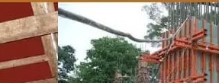
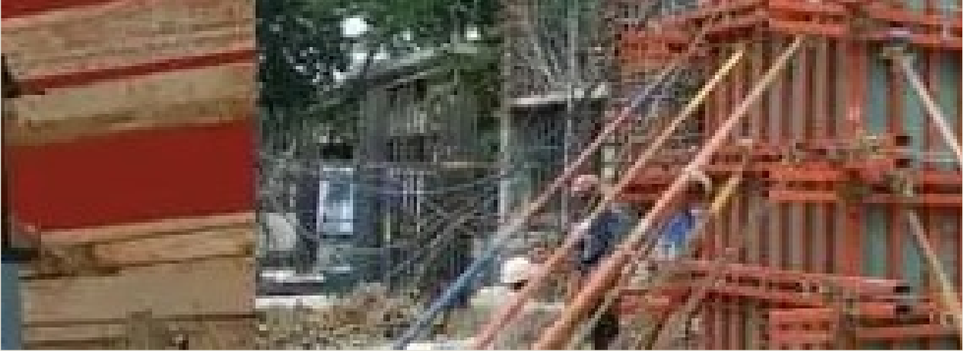
SHUTTERING is used to support vertical members.
Hence, formwork for
columns, footings, or retaining
walls is known as
shuttering.

Slide 6
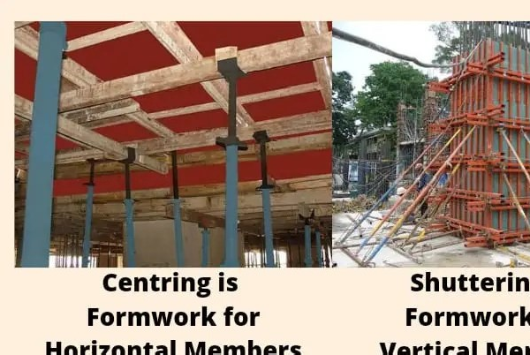

Slide 7
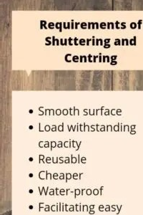

Slide 8
Formwork is mainly classified on the basis of different materials. The different types of formwork materials are as follows:
Timber formwork
Plywood formwork
Steel formwork
Aluminium formwork
Plastic formwork
Types of Formwork

Slide 9
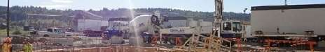
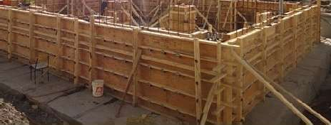
1. Timber Formwork
Timber formwork is considered to be one of the oldest and most conventional types of formwork. Despite being one of the oldest in its category, it is widely used till date as it is considered to be one of the most flexible and low-cost materials. One of the major reason timber forms are widely used is that it is a low-cost material and also lightweight as compared to steel.

Slide 10
Advantages
Timber
Disadvantage
t can be used in lesser repetitions (8-10 times) as compared to steel and plywood formwork
The surface of timber form is
Installation and stripping are easier due to their flexibility.
Lower cost as compared to other types of formwork materials.
Formwork
Because of its flexible nature, it is preferred as it is easy to customize in terms of size.
Timber is locally available.
rougher than plywood or steel. So the surface finish of the concrete element wouldn’t be that great.
If the wood is not seasoned properly, it may not produce the desired results

Slide 11
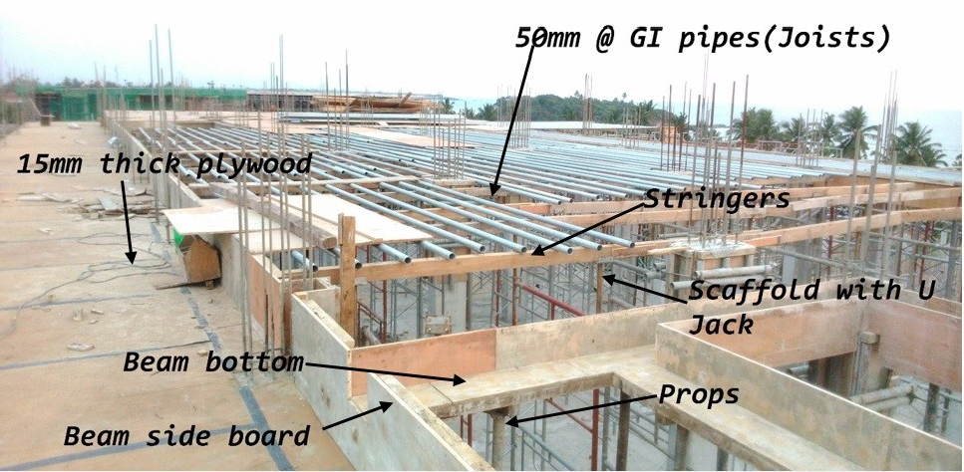
Plywood Form work
Plywood is a man-made material. It is made up of thin sheets of plies glued up together to form a sheet of wood. This formwork material is an upgraded type of conventional timber formwork. Practically, plywood sometimes can be as cheaper as timber because of its more repetitive uses as compared to timber.

Slide 12
Advantages
Disadvantage
Heavier in weight as compared to timber.
Lesser repetitions of use as compared to steel formwork.
It may get damaged if proper care of plywood forms is not taken at the time of installation or stripping
Labor costs can be reduced by using plywood formwork as it can cover a larger area per sheet.
The installation process is easier than that of steel formwork.
Plywood formworks are more durable than timber as they are processed forms of wood.
Comparatively economical material
PLYWOOD FORM WORK

Slide 13
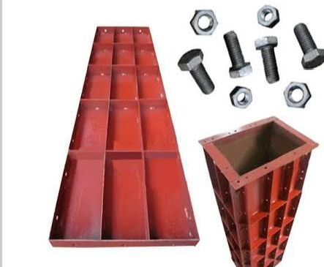
Steel Formwork

Slide 14
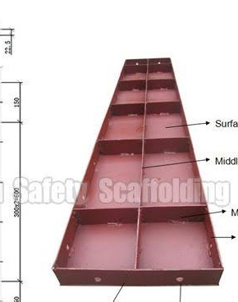

Slide 15
Steel
Steel formwork is made up of panels fabricated out of thin steel plates fixed along the edges by small steel angles. Unlike timber and plywood formwork, steel shuttering is installed using suitable size clamps and nuts.
Although steel panels have a high initial costing, it is a lot more
Formwork
durable as compared to any other type of formwork. So, in the long run, they turn out to be as economical as any other type of formwork.

Slide 16
Advantages
Disadvantage
It is possible to manufacture steel formwork in any required size and shape, such as curved or circular. So steel formwork is also used where circular columns and structures are to be constructed.
Due to its
strength, stiffness, and durability, the number of reuses is a lot more than that of timber and plywood formworks.
High initial cost and high maintenance cost.
The maintenance of steel formwork
Steel Formwork
plates is complex unlike any other type of formwork.
Transportation and storage of steel formwork is complex.
Due to its heavy weight placement of shuttering panels in its accurate position becomes tough at times where there is a use of larger sized panels.

Slide 17
Aluminium Formwork
Aluminium formwork is very much similar to steel formwork. It is, of course, made up of aluminium. The main difference between steel and aluminium formwork is that the aluminum forms are lighter in weight as compared to steel formwork. This is because aluminium has a lower density than that of steel.

Slide 18
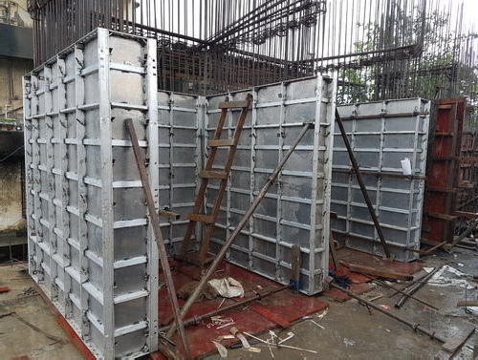

Slide 19
Advantages
Disadvantage
Aluminium Formwork
Aluminium forms are lighter than steel so its transportation becomes a bit easier.
Like the steel form
plates, these also turn out to be economical if used for more number of times.
It has comparatively low strength. So it cannot be used for very heavy concrete work.
Once manufactured, it is not possible to alter the formwork plates.

Slide 20
In this type of formwork system special grade recyclable
plastic, also known as geoplast (Acrylonitrile Butadiene Styrene – ABS), is used.
It does not allow any kind of chemical reaction to crop up between the concrete and the plastic form. Also, it does not let the concrete material stick on the plastic forms.
Plastic Formwork

Slide 21
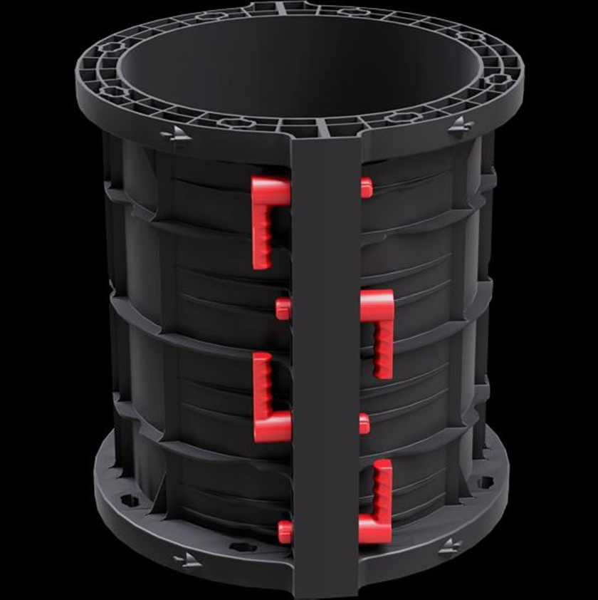

Slide 22
Advantages
Disadvantage
The initial cost is high.
The load-carrying capacity of plastic formwork is comparatively low.
It can be used more than 100 times if proper care of forms is taken.
Overall economic in the long run.
Light in weight.
Easy to install, strip and handle.
Labour friendly.
Smooth finish when concrete is hardened.
Plastic formwork is said to have no effect on the environment (eco- friendly) as it is made up of recyclable plastic.
Plastic Formwork

Slide 23
De-Shuttering Formwork
The removal process of formwork is called De-shuttering. The Formwork can be removed only after concrete has achieved sufficient strength

Slide 24
Method and Period of
The formwork should be constructed in such a manner that it is possible to remove the different components in the following order of sequence:
Shuttering forming vertical faces of walls, beams, and columns sides (which bear no loads but are used only to retain the
Removing
Formwork
concrete) should be removed first.
Shuttering forming soffit to slabs should be removed next.
Shuttering forming soffit of beams, girders or other heavily loaded shuttering should be removed in the end.

Slide 25
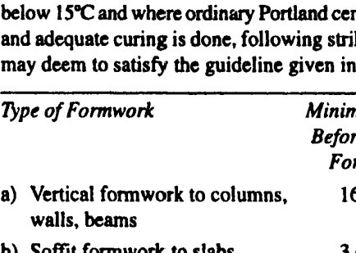
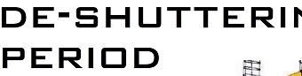
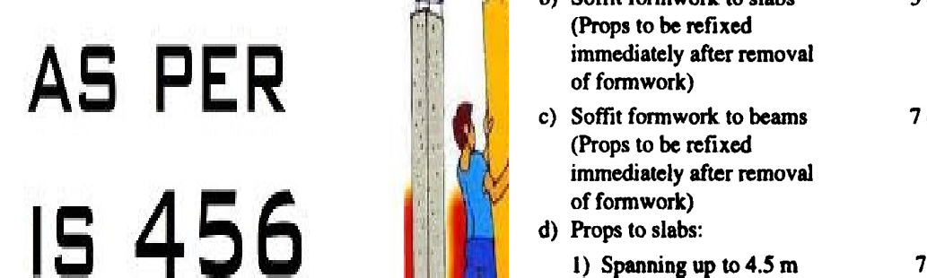

Slide 26


Thank you

Slide 27


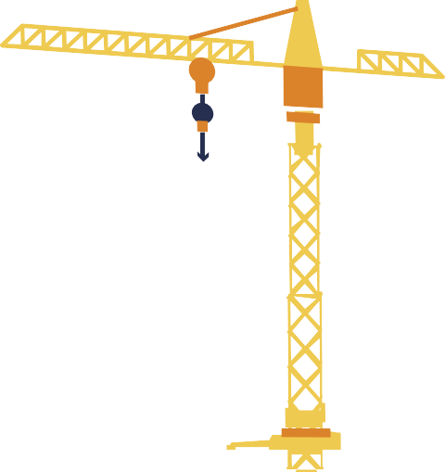
Slip-Form Construction
PRESENT BY:- JATIN GARG 2014036/2004436

Slide 28
Table of contents
01
02
03
Introduction
Procedure
Components
04
05
06
07
08
Types
Precautions
Applications
Safety features
Advantages & Disadvantages

Slide 29
Introduction
01.

Slide 30
Introduction
SLIPFORM CONSTRUCTION, is a continuously formed or slip-form construction is a construction method in which concrete is poured into continuously moving form
. Slip forming is used for tall or vertical structures (such as bridges , towers , buildings , chimneys & dams ) as well as horizontal structures such as roadways.

Slide 31


INTRODUCTION
Slipform is a construction method for reinforced concrete walls, generally lift and stair core walls, and is often economical for buildings more than ten storeys in height. Slipform involves the formwork for the walls being raised in a continuous process as the wall concrete is poured.
The height of the formwork is designed such a way that, during the pouring of the upper level formwork, the concrete poured in the below formwork would have gained initial setting. The concrete exposed when the formwork moves up will remain firm

Slide 32


02
Procedure

Slide 33


Procedure
Assembly can only start once the foundation are in place and the wall starter is in correct alignment.
Horizontal crossbeams connect these yokes.
Hydraulic jacks are attached to these crossbeams for simultaneous upward movement.
Height of the slip from ranges from 1.1 to 1.5 meters.
Yokes and crossbeams also used to support the working platforms.
Structures should be rigid and shape maintained at all times.
Make sure there is no lag or else it prevent the structure from free upward movement.
It is also possible to reduce the wall thicknesses as the construction gains the height and arrangement have to be made in the the slip form structure that will enable such reduction at regular interval.

Slide 34


03
COMPONENTS OF SLIP-FORM CONTRUCTION

Slide 35
Components Of Slip-Form
01
02
03
04
05
Wales
Yokes
Jacks
Jack Rods
Panel

Slide 36
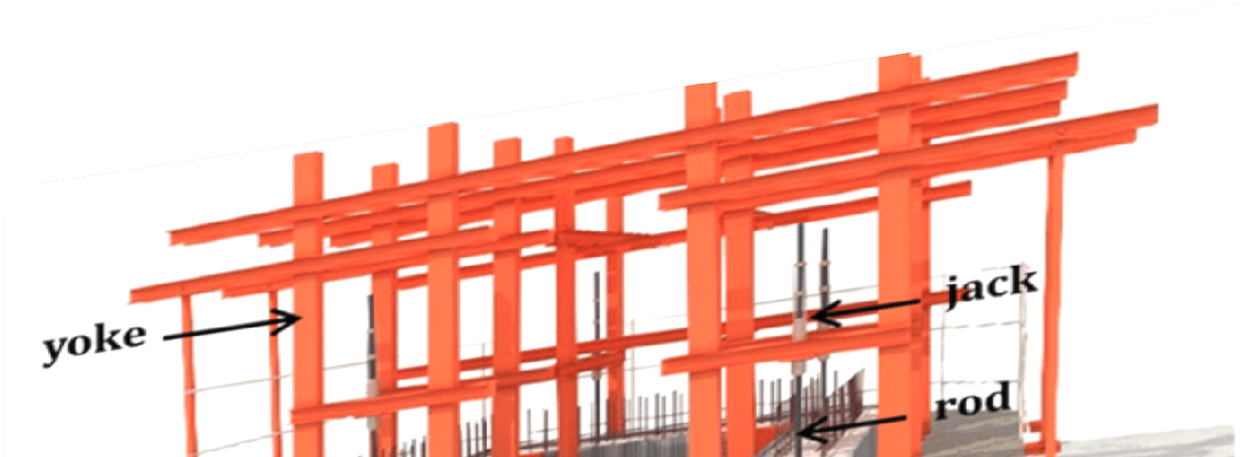
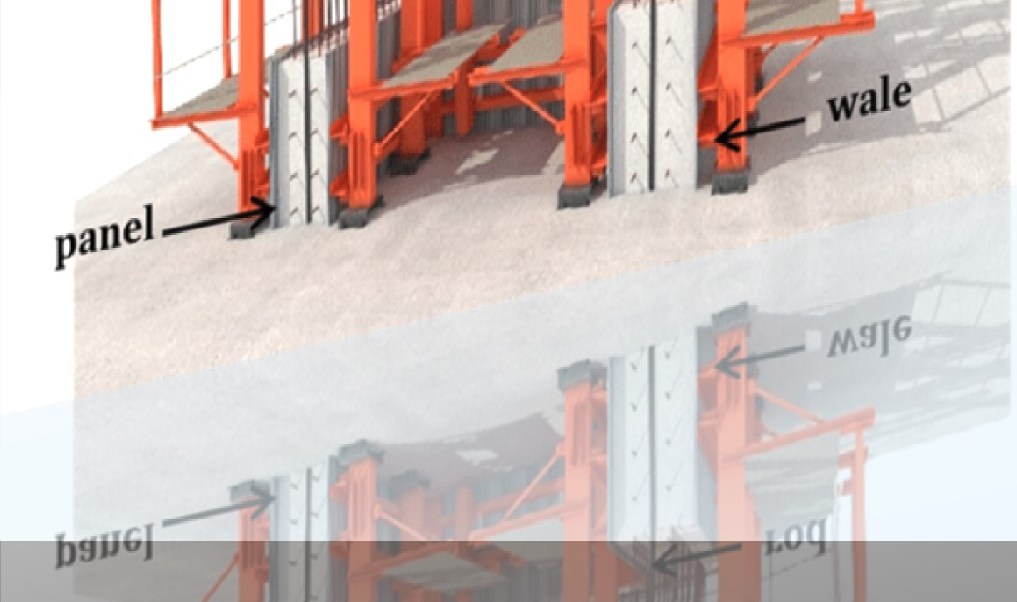

Slide 37
Components Slip-Form
Wales: It holds vertical forms in place. It also supports various platforms and scaffolds.
Yokes: It transmits the lifting forces from the jacks to the wales and resists the lateral force of plastic concrete within the form.
Jacks: It mounts on the jack rod and provides the necessary force to lift the entire slip form system. They serve as a work area for placing and finishing
Jack rods: These are climbed up by Jacks.
Panel: Is normally size between 1.1m and 1.3m high and made up of steel plates

Slide 38
Types
04

Slide 39
Types Of Slip-Form
01
02
03
04
05
Vertical Slip-form
Horizontal Slip-Form
Cantiliver Jump Slip-Form
Egg Shaped Slip-Form
Canonical Slip-Form

Slide 40
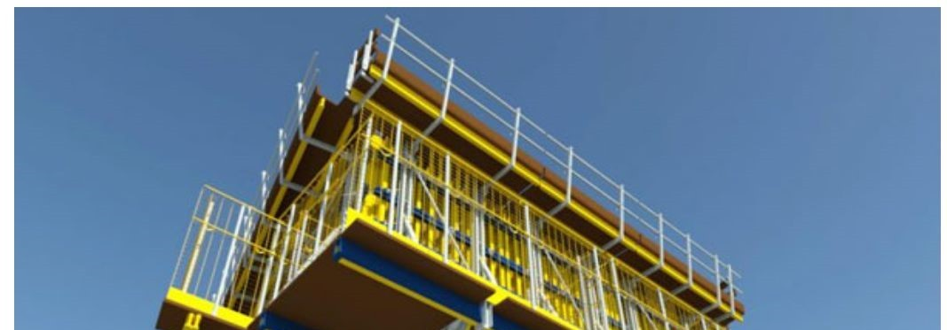
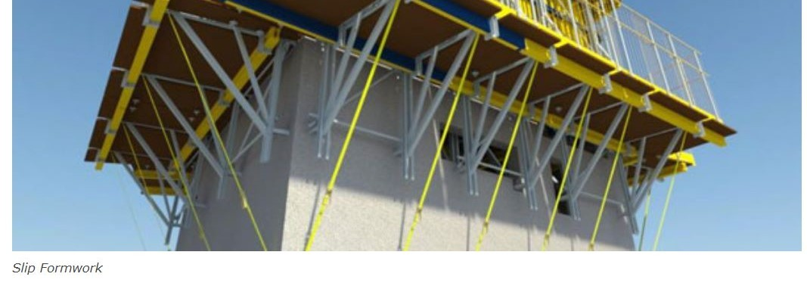
1-Vertical Slip-Form
The vertical slip forming technique uses the extrusion concept in concrete construction. It depends on the quick setting properties of the concrete that is required between the initial strength gain with the ability to work.
So during the concreting process, the concrete form and working platform are raised together in a continuous vertical sliding motion utilizing hydraulic jacks.

Slide 41
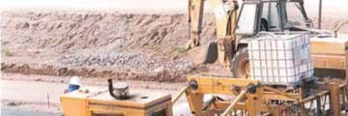
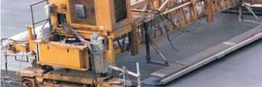
Horizontal Slip-Form
Horizontal slip form is used for pavement and traffic separation walls. In this method, concrete is laid down, vibrated, worked, and settled in place while the form itself slowly moves ahead.

Slide 42
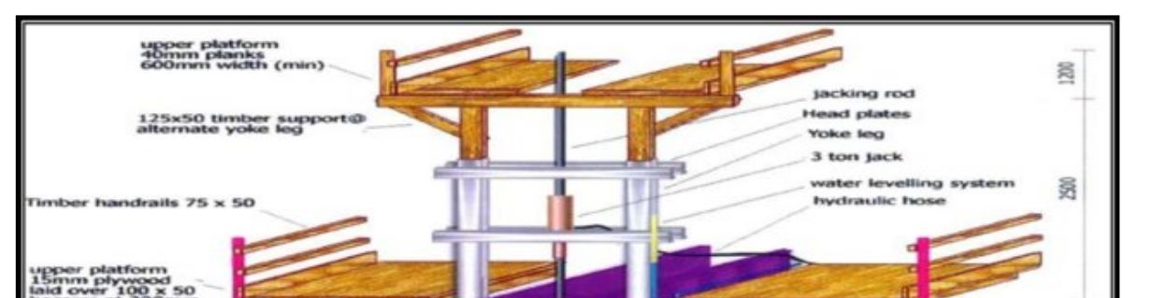
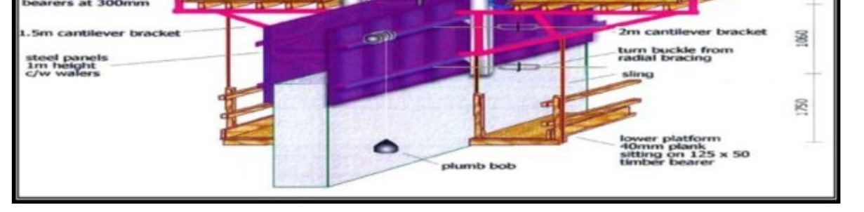
03-Cantilever Jump Form Method
This Slip-Form method is used for climbers which are independent of cranes. It is attached to a large formwork area at story height. This system gives maximum protection, providing a complete self- climbing formwork system that is independent of cranes for walls, columns, supports, and floor beers.

Slide 43
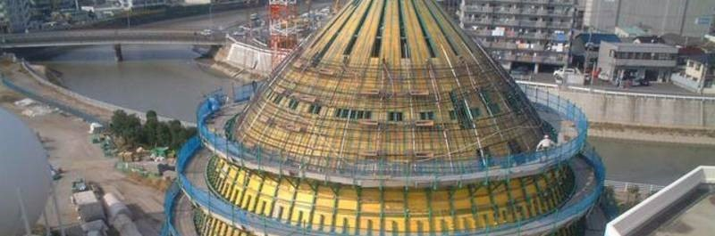
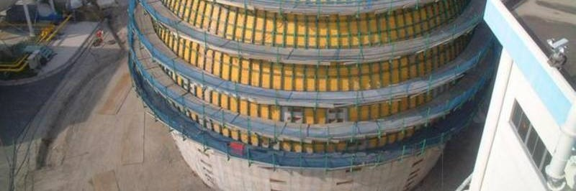
Egg Shaped Slip Form System
This system is based on the jump form principle which can be adapted to any geometric shape. Individual curvature adjustment can be done by adjusting the axis and vertical circumferential slope. It can be adjusted independently on each side of the wall and products of optimal working condition.

Slide 44
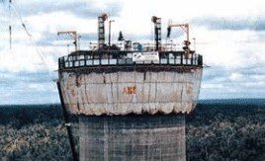
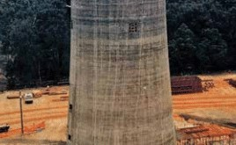
05-Canonical Slip-formwork
Canonical slipforming offers monolithic construction of decreasing and increasing layouts without any steps.
For slipforming variable cross-sections, horizontally moveable formwork structures are used. These are mounted on hydraulically adjustable tapering elements.
The overhead girder star with its centerpiece forms the central point of the tower and connects all main beams to a uniform, closed scaffolding. At the same time, it serves as an upper work platform.

Slide 45
Precautions
05

Slide 46


Precautions
1
Concrete is continuously protected against the loss of moisture and rapid temperature changes
for 7 days .
2
Unhardened concrete is protected from rain and flowing water
3
Prevent plastic Shrinkage
4
Plastic cracks are filled by injection of epoxy resins

Slide 47
Applications of
06
slip-form construction

Slide 48
APPLICATIONS OF SLIP-FORM CONSTRUCTION
Slip-form construction is used for tall structures, such as towers, buildings and dams as well as horizontal structures such as rodways barriers. It enables continous, non- inturpted, cast in place joint less concrete structures which have superior performance characteristics over construction method using discrete form elements. Slip forming relies on the quick setting properties of concrete and requires a balance between quick setting capacity and workabilty.

Slide 49
Applications of slip form construction in daily use life
01
02
03
04
Construction of regular core high rise structures
Construction of chimney
Construction of steel tanks
Construction of water towers

Slide 50

07
Safety Features

Slide 51
Safety Features
Working platforms, guard rails,ladders, and windshields should be built into the system.
The completed formwork system is study.
Concrete strength should be checked at a certain period of intervals.
Workers can quickly become familiar with the health and safety aspects.
All parts should move at a uniform rate, no jam in formwork or jack should be present.
Forms must have lateral supports.

Slide 52
Advanatges &
08
Disadvanatges

Slide 53
Advantages
A major cost of concrete structure construction is the required formwork to retain and be able to support itself and other imposed loads.
The form work needs to be continually removed to newer locations and then retrected.
Continous use of manpower and lifting equipments like cranes.
In the case of slipform building, the formwork is erected only once and remains intact untill the entire structure is completed.
Great reduction in the cost of formwork as well as time saving for re-erection.
Cost effective
The reduction in the movement of the formwork and workers also leads to far more safe working conditions that also it make a major advantage

Slide 54

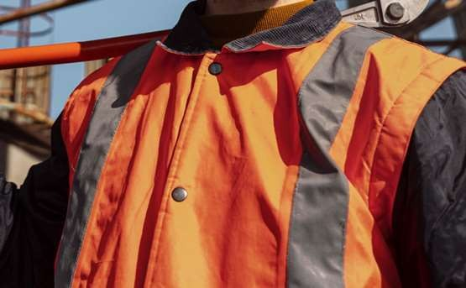
Disadvantges
High –cost for initial setup
Requires Specialized workers and expertise
Need sophisticated Equipment
o Dimensional Accuracy can go low in certain conditions

Slide 55




Slide 56
Scaffolding

Slide 57
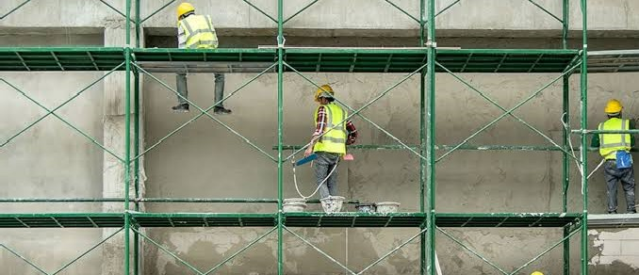

Slide 58
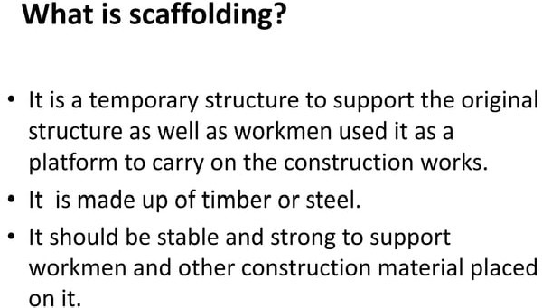

Slide 59
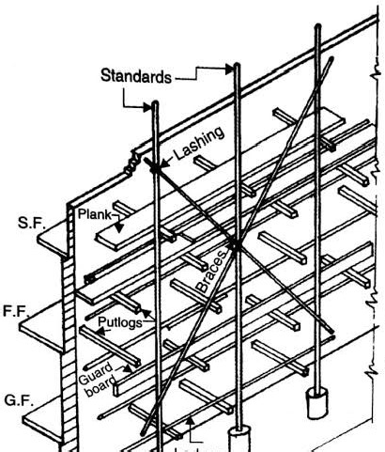

Slide 60
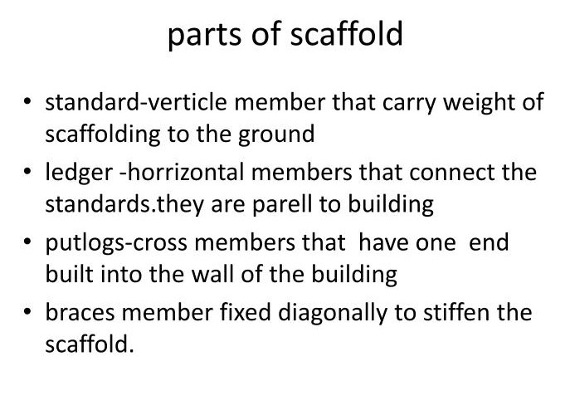

Slide 61
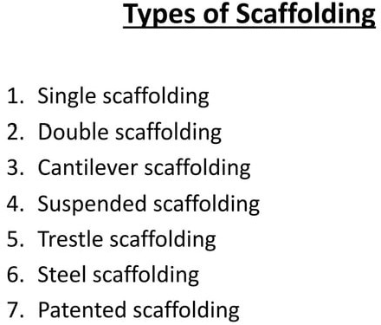

Slide 62
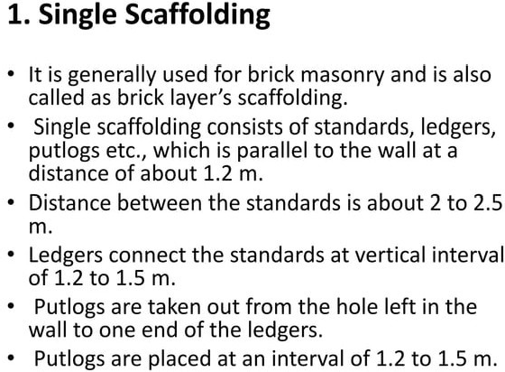

Slide 63
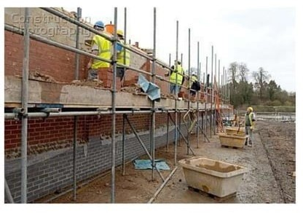

Slide 64
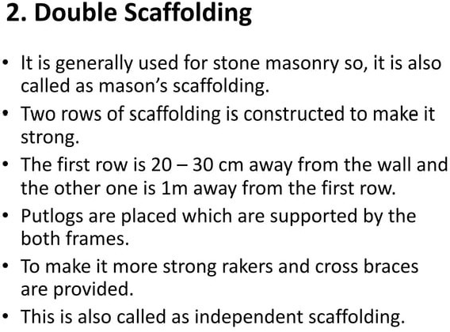

Slide 65
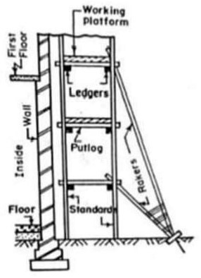

Slide 66
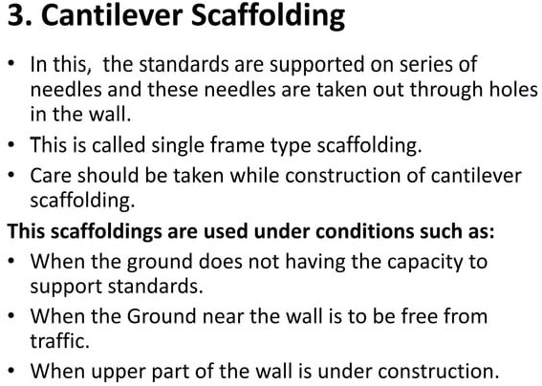

Slide 67
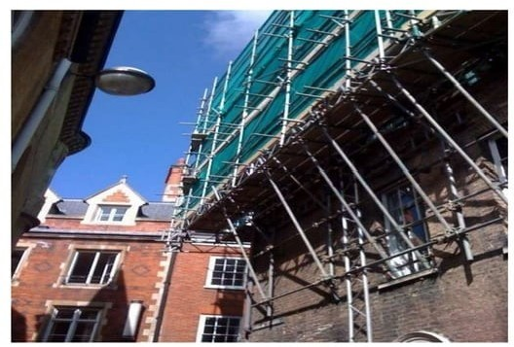

Slide 68
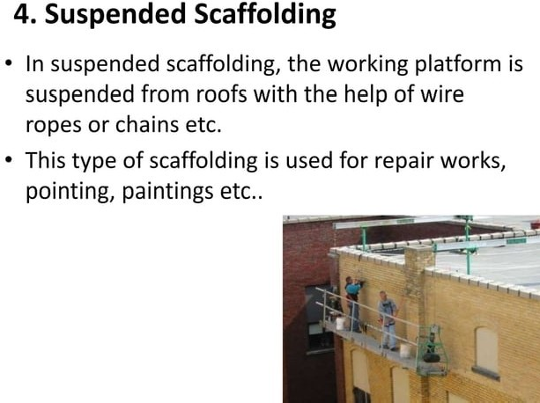

Slide 69
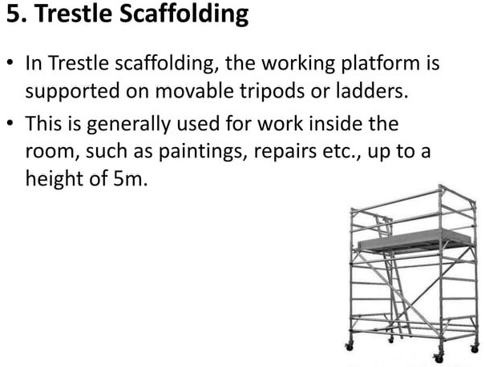

Slide 70
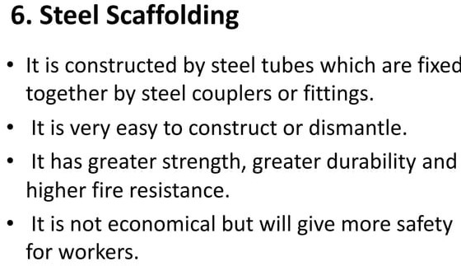

Slide 71
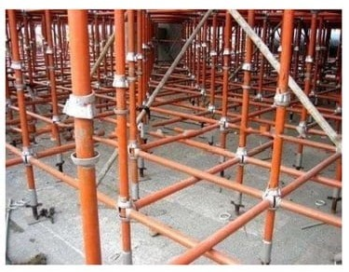

Slide 72
